Slide 1

Welcome to the Kindergarten,
2020-2021 School Year!!
Teachers:
Ms. Brantley
Mrs. Clark
Ms. Heggs

Slide 2

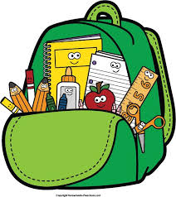
Agenda
Welcome/Intro. of Teachers
Kindergarten Expectations
Supply List
Canvas
Importance of I-ready and Myon
Questions?

Slide 3


Welcome to Kindergarten! Let’s Meet Your Teachers!!
Ms. Brantley
Ms. Clark
Ms. Heggs

Slide 4

Kindergarten Expectations
      Students attend school regularly.
      Follow Class, School Rules and Teacher Expectations.
      Participate in Class/Be prepared with school supplies.
      Complete Class and Homework Assignments Daily and turn in via, (face to face), and in Canvas.
      Have Fun and enjoy the Kindergarten Experience!

Slide 5
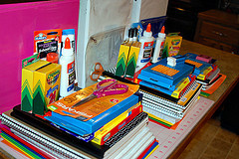
Kindergarten Supply Lists
Required: * Wish List:
2 boxes of crayons * 2 Large bottles of hand sanitizer
2 packs of pencils * Pack of Baby Wipes
6 glue sticks * Clorox Wipes
4 composition books * Extra pack of Dry Erase Markers
6 double pocket folders * Copy Paper
3 packs of notebook paper
headphones-with a plastic bag to hold them.
1 pair of scissors
3 boxes of facial tissue
1 pack of erasers
Pack of dry erase markers

Slide 6

Welcome to Canvas- A new Online Learning Management System
Canvas is accessible through your Child’s Launchpad Account
Teachers, students, and parents will be accessing Canvas this year as a new virtual learning tool.
Watch the Introduction Video below about Canvas.
Parent Information:
Parent Orientation
Parent Self-Registration (create your account here)
Instructions for parent login can be found here.

Slide 7
Kindergarten Online Protocol
Kindergarten has an online class protocol that should be followed to ensure your child receives the highest quality instruction possible. Here are the expectations for students learning online:
Students should be up, dressed, and has eaten breakfast/lunch before logging on at their Scheduled time: AM Session: 8:50 am. PM Session: 12:50 pm.
Student’s work area should be clear of any distractions: television, games/toys, music or adults having loud distracting conversations during online learning and all household members who are walking by computer should be dressed appropriately so distracted learning will not occur from your child and their classmates who will see your child and their learning environment online.
Student’s work area should be set up for easy access to computer and other needed supplies for learning.
An adult should be available to assist your child as needed to help with using the computer: logging in, using technology tools to complete assignments /activities and to submit assignments when student has completed them.

Slide 8


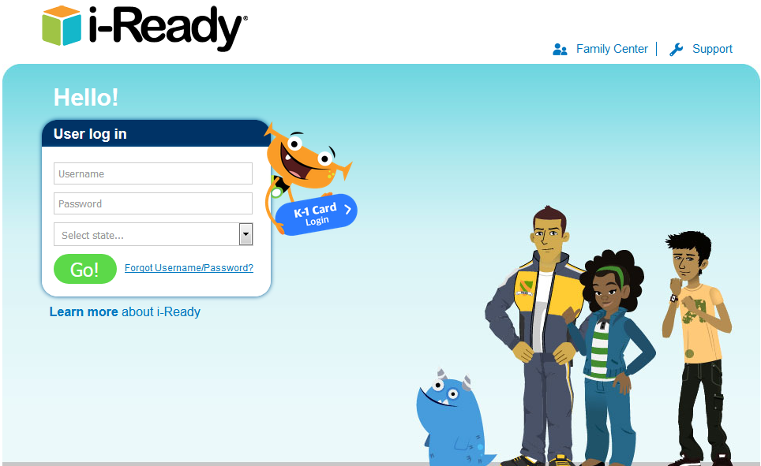
i-Ready
I-ready is an important tool that reinforces and tests students on what they are taught in the classroom.
Covers Reading and Math.
  Reading Level-BR400
  Math Level
  1 Level Below- EM70Q-45Q
  On-Level- 45Q-10Q
You can access I-Ready through your child’s Launchpad Account.

Slide 9

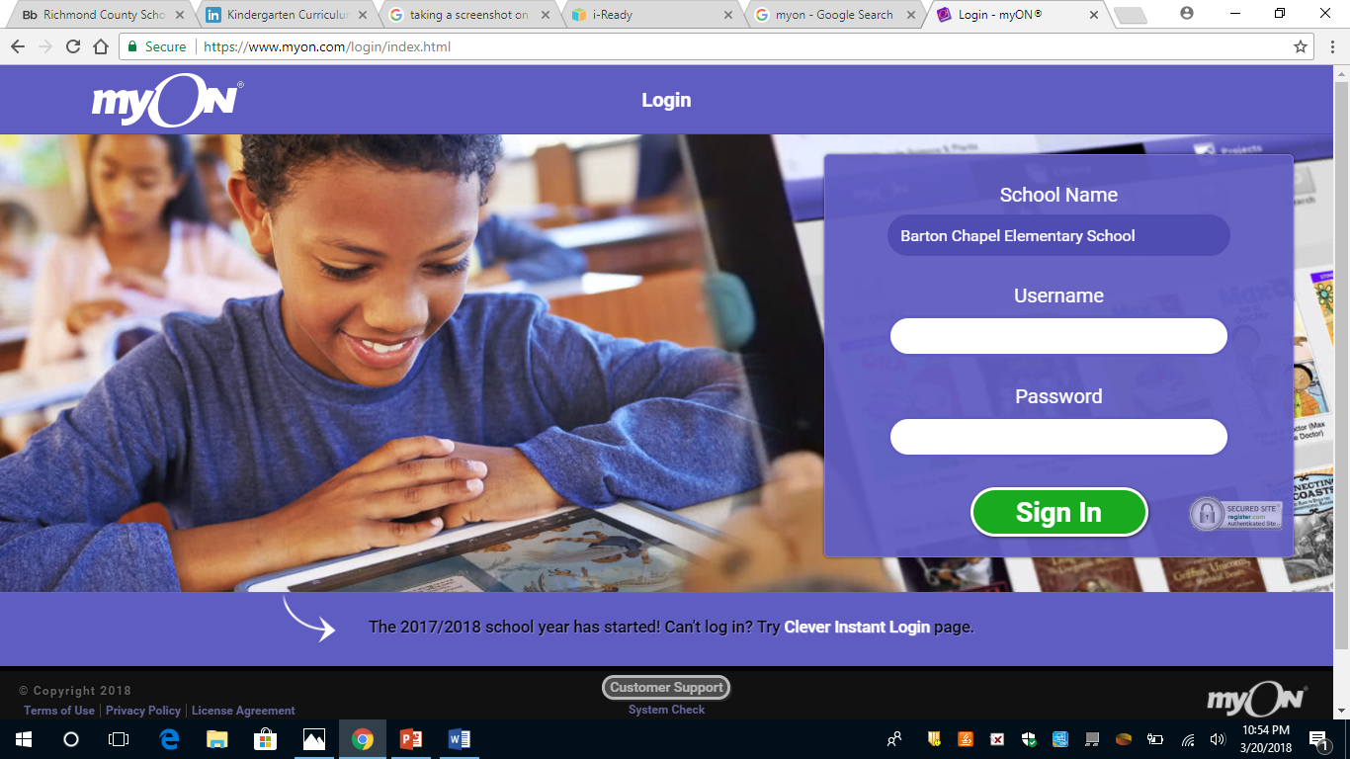
My On
Helps students practice reading.
Introduces them to different types of books. (stories, comics, biographies, information books about animals, etc.
Access through your child’s Launchpad Account.

Slide 10
Questions?
Email your child’s Teacher:
Ms. Brantley: brantjo@richmond.k12.ga.us
Mrs. Clark: clarkes@richmond.k12.ga.us
Ms. Heggs: heggsca@richmond.k12.ga.us

Slide 11


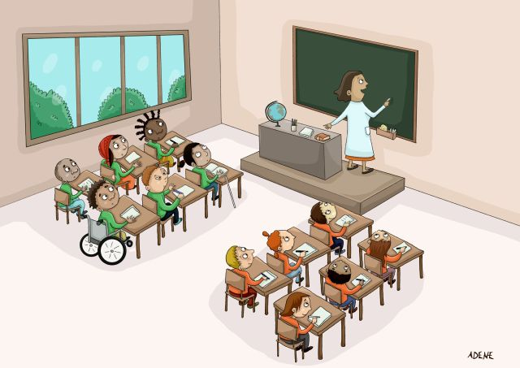
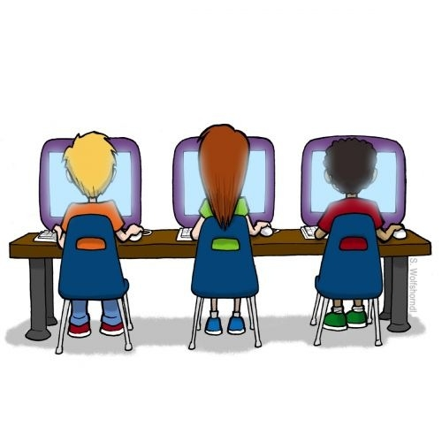

Thank you for Watching this Power Point!
We are looking forward to a new and exciting Kindergarten Adventure, full of fun and Learning with you and your Child!
Have a great Year!

